Slide 1
Reality Check

Slide 2
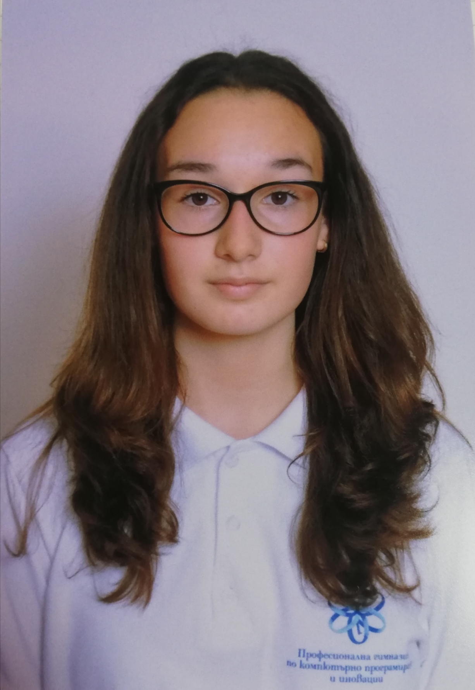
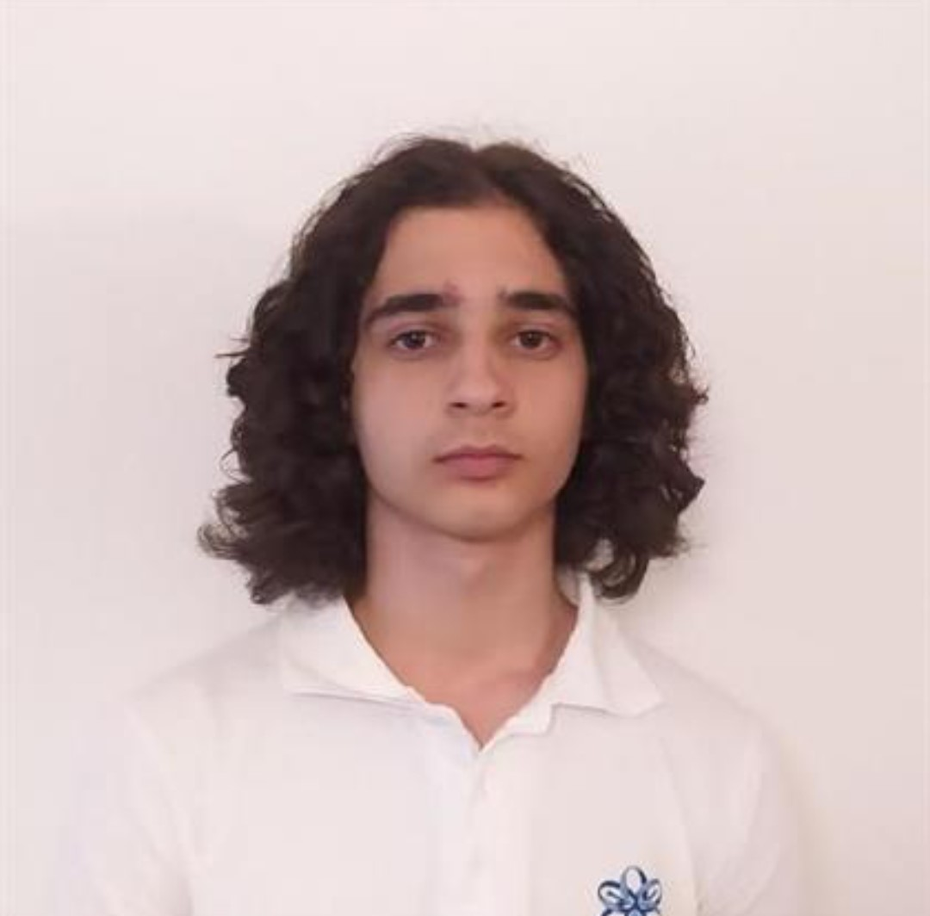
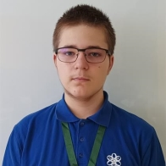
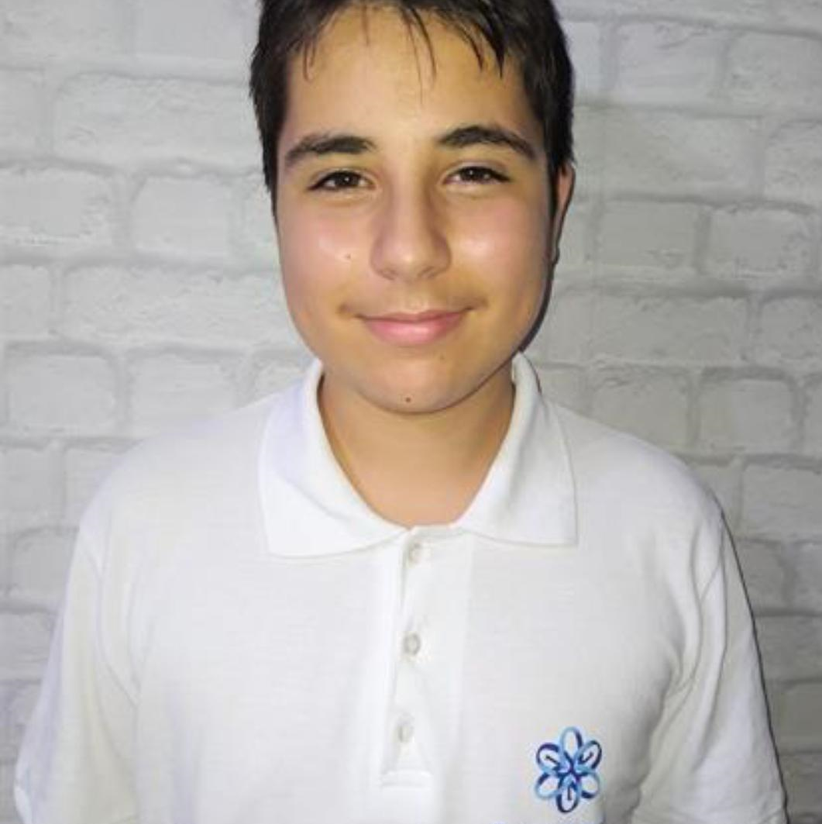
Our team
Scrum Trainer
Backend Developer
Frontend Developer
QA

Slide 3
Idea
The idea of ​​the game is to make math fun and relevant for everyone

Slide 4
Realization
Group in Microsoft Teams
Create a game
Test the game
Documentation
Present the project

Slide 5
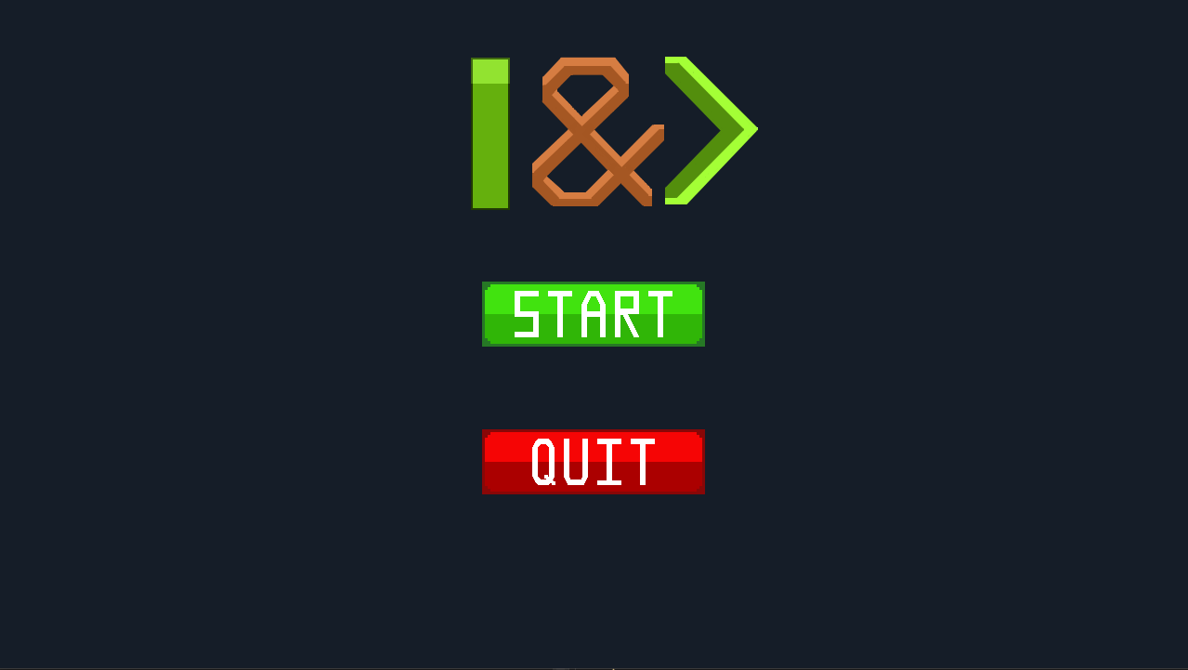
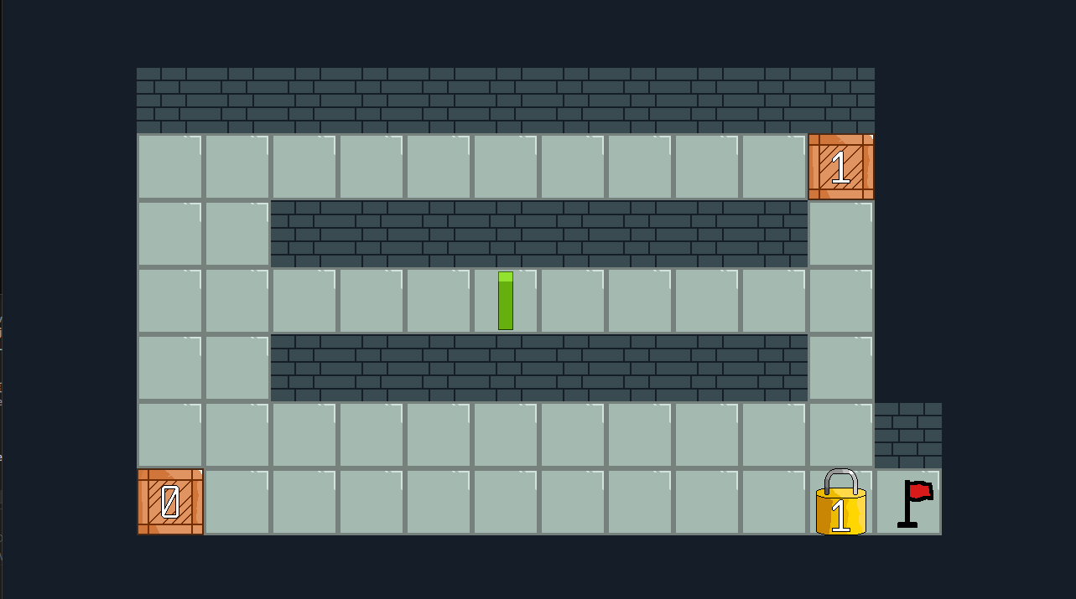
Our game

Slide 6






Used programs

Slide 7
Thank you for your attention!

